Slide 1
Apache Kafka

Slide 2
Agenda
Kafka Overview
Understanding Kafka
Topics, partition and offsets
Producers and message keys
Consumer and consumer grps
Kafka broker discovery
Zookeeper
Assurance by Kafka

Slide 3
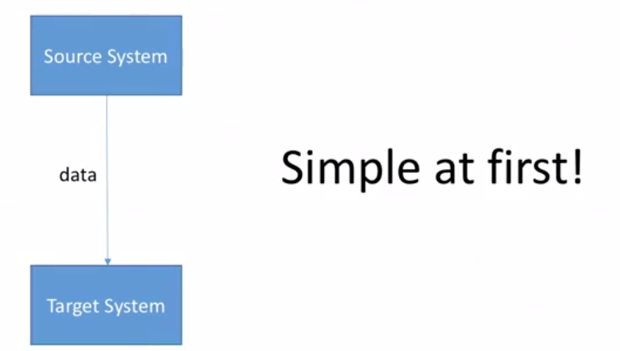
How companies Start

Slide 4
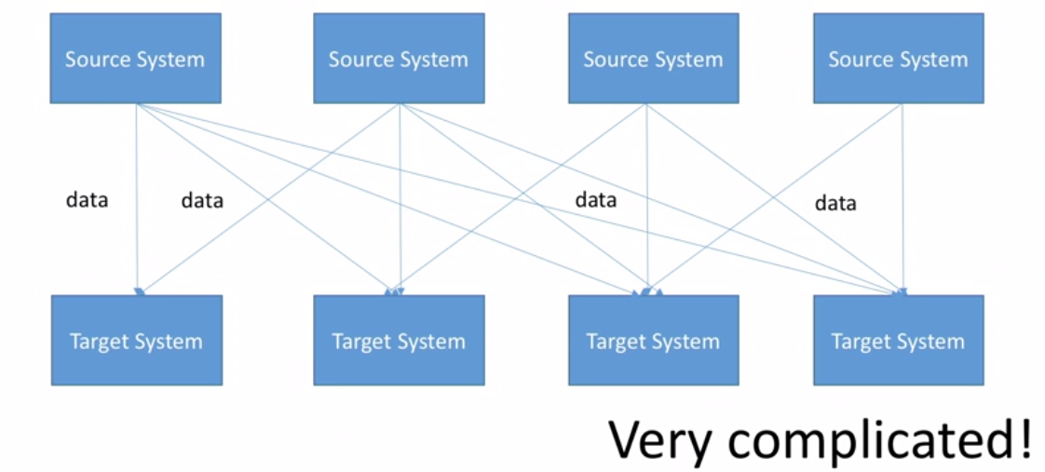
After a While

Slide 5
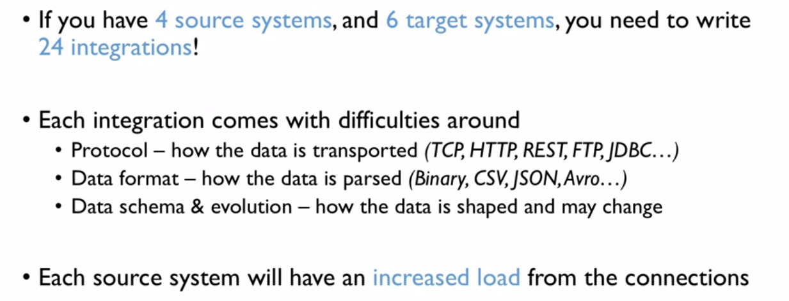
Problem Organizations are facing

Slide 6
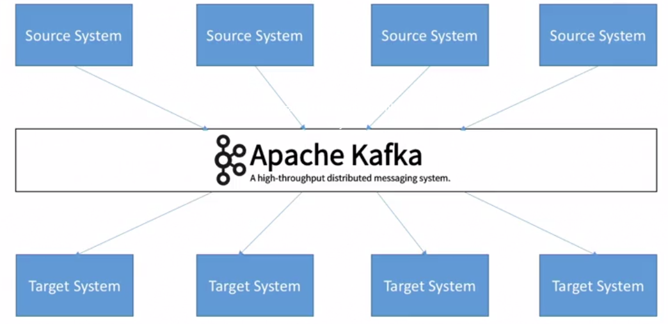
Why Kafka ? Decoupling of Data Streams and Systems

Slide 7
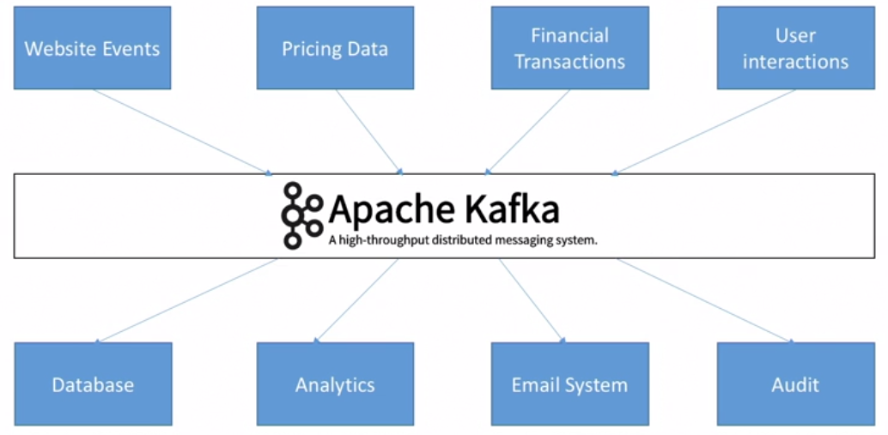
Why Kafka ? Decoupling of Data Streams and Systems

Slide 8
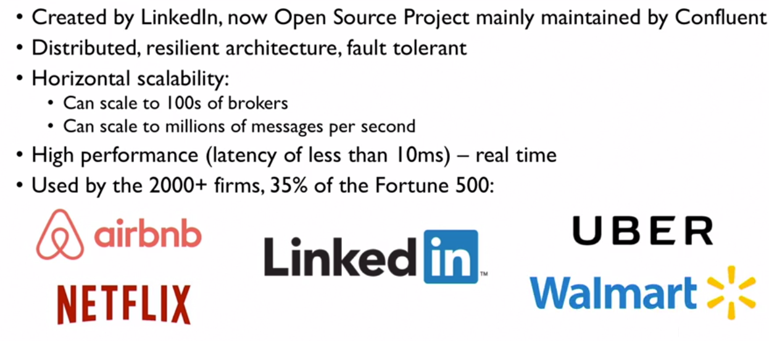
Why Kafka ? Decoupling of Data Streams and Systems

Slide 9
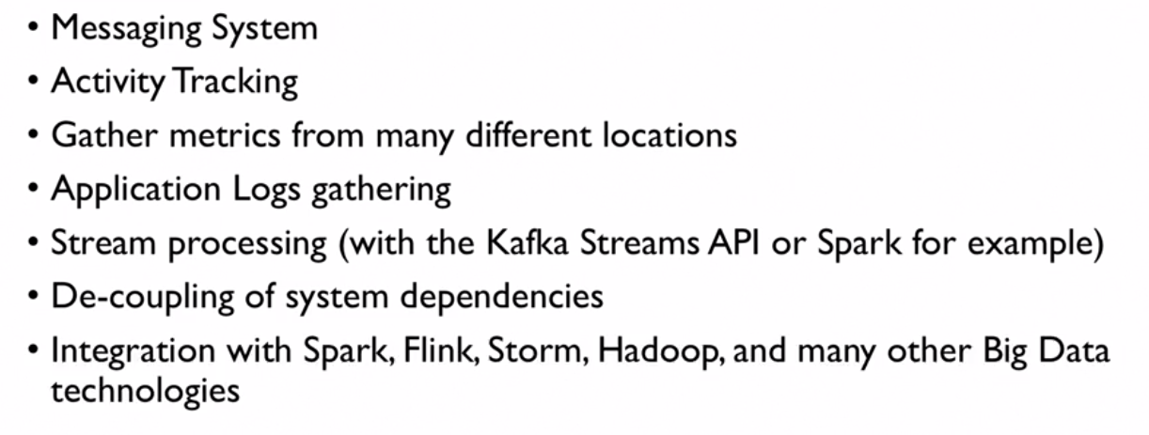
Apache Kafka Use Cases

Slide 10
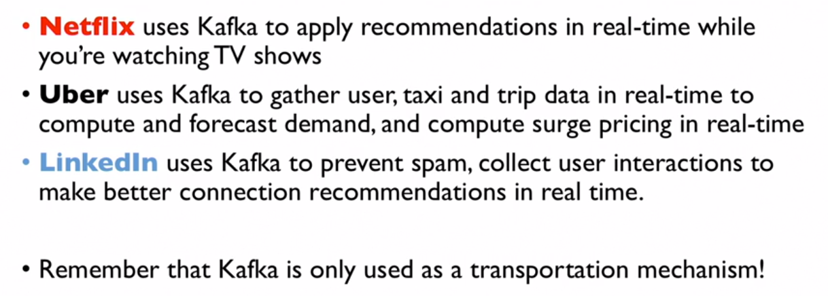
For Example ………

Slide 11
Topics , Partitions and Offset

Slide 12
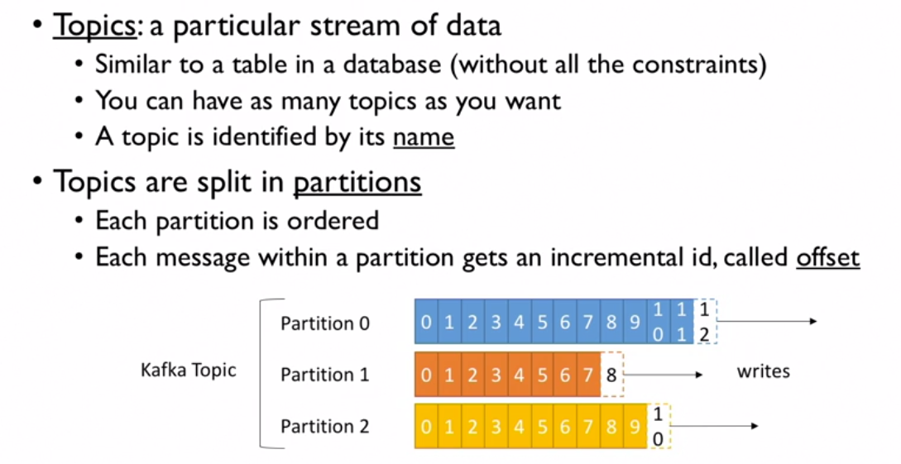
Topics , Partitions and Offset

Slide 13
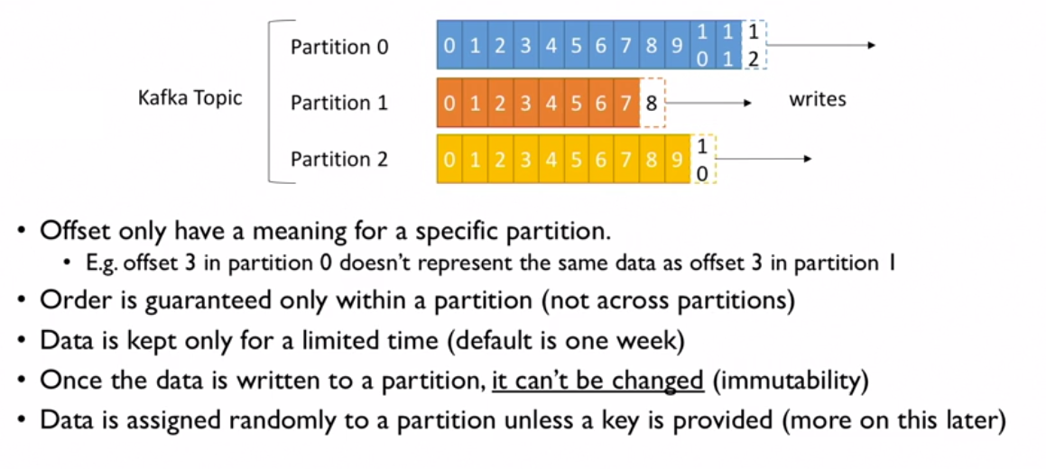
Topics, Partitions and Offsets

Slide 14
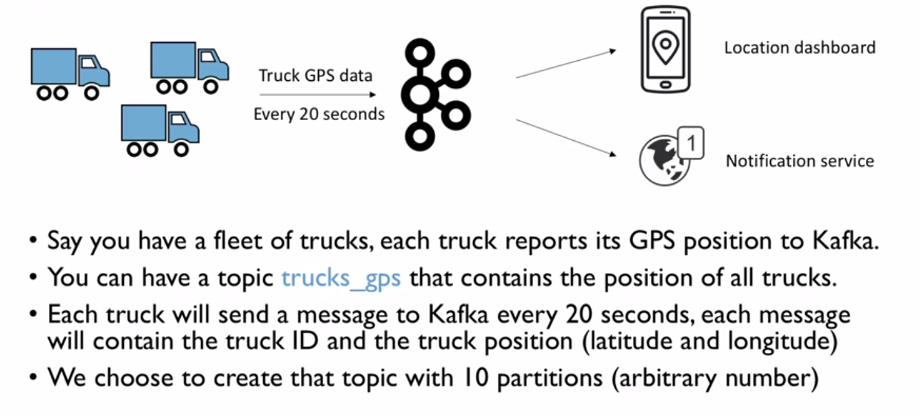
Topic Example : trucks_gps

Slide 15
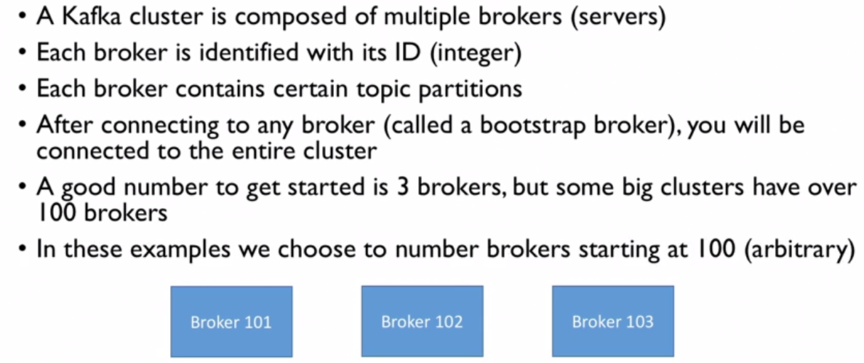
Brokers

Slide 16
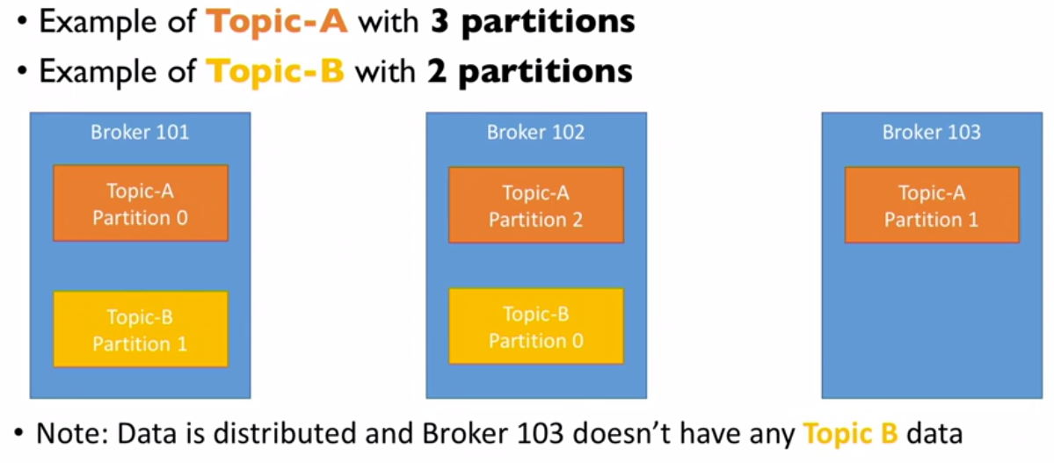
Brokers and Topics

Slide 17
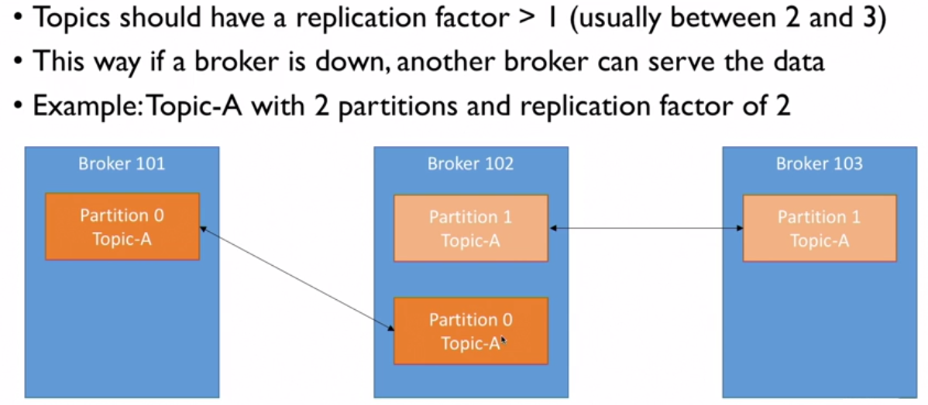
Topics and Replication Factor

Slide 18
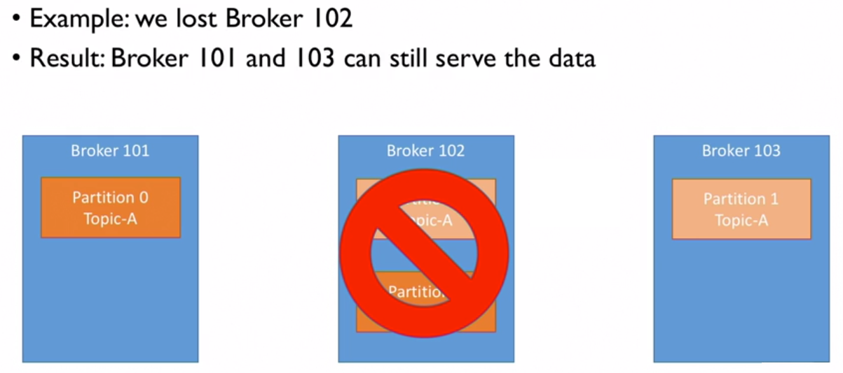
Topics and Replication Factor

Slide 19
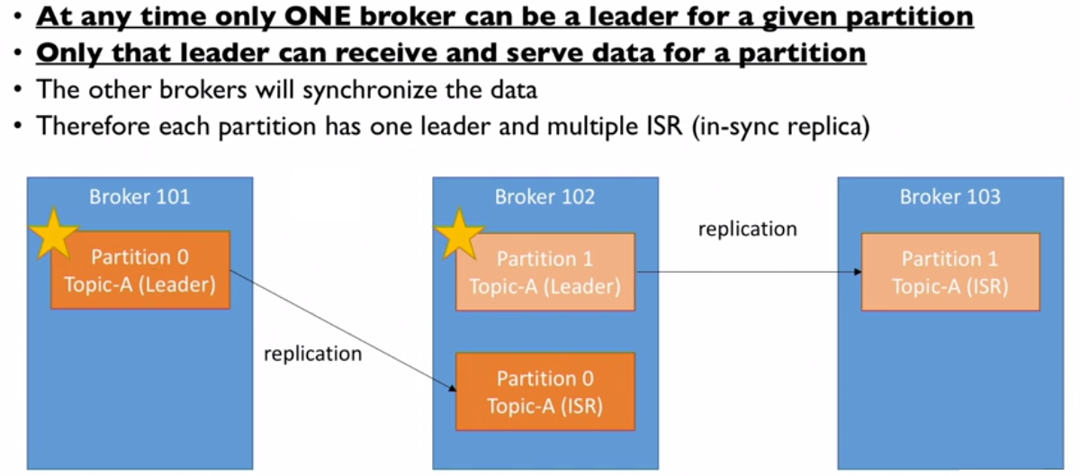
Concept of Leader for a Partition
**Note : Leader and ISR is decided by Zookeeper

Slide 20
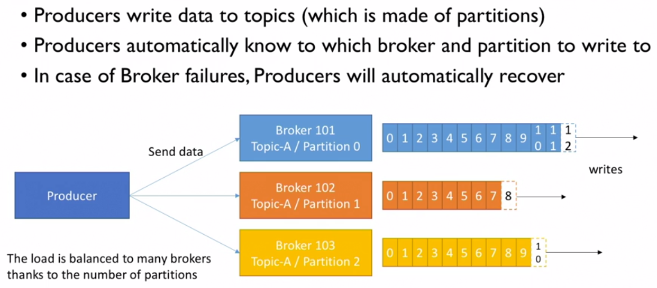
Producers

Slide 21
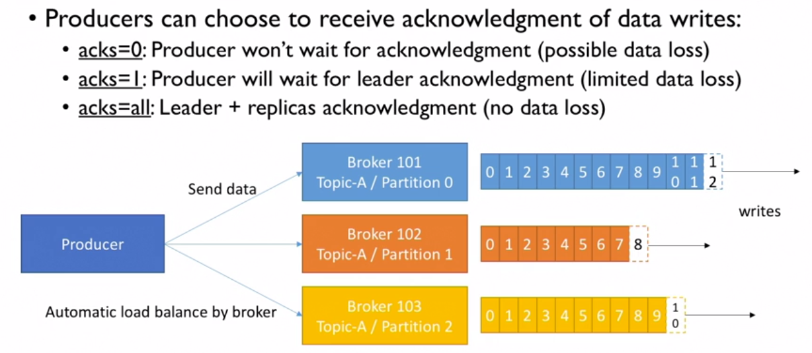
Producers

Slide 22
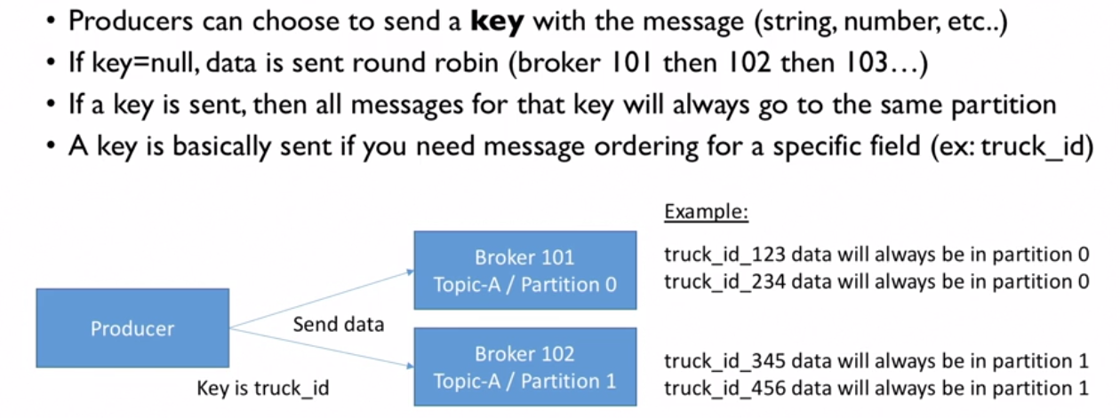
Producers :Message Keys
**Note :We get this guarantee ,thanks to hashing key ,which depends on the number of partitions .

Slide 23
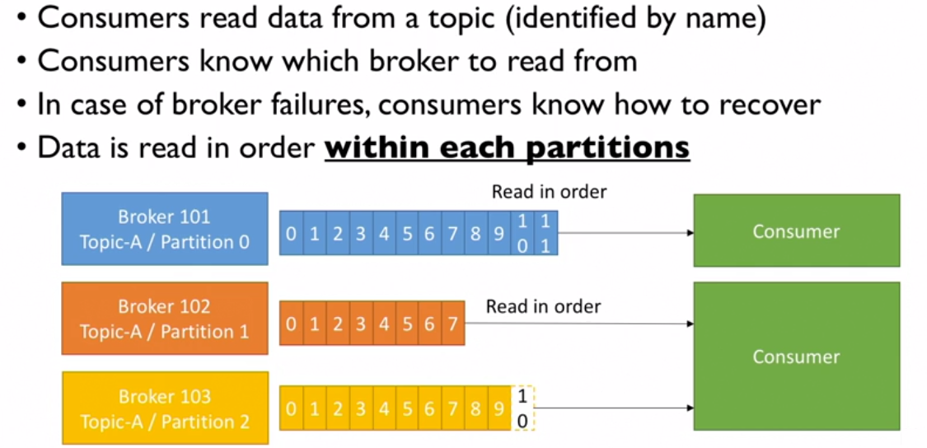
Consumers

Slide 24
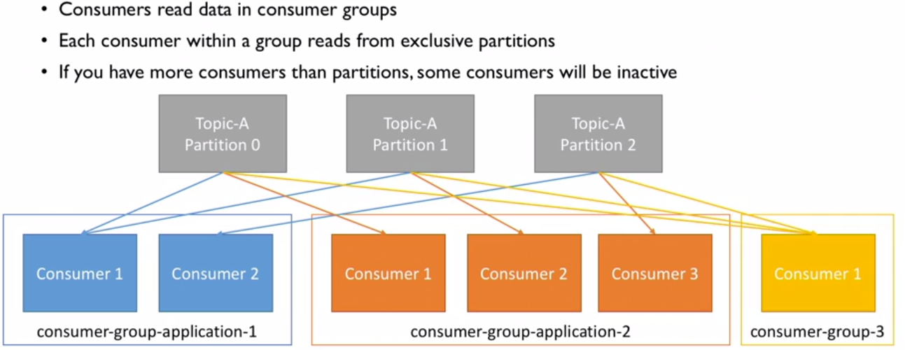
Consumers Groups
**Note: consumers will automatically use a GroupCoordinator and ConsumerCoordinator to assign a partitions to a consumer

Slide 25
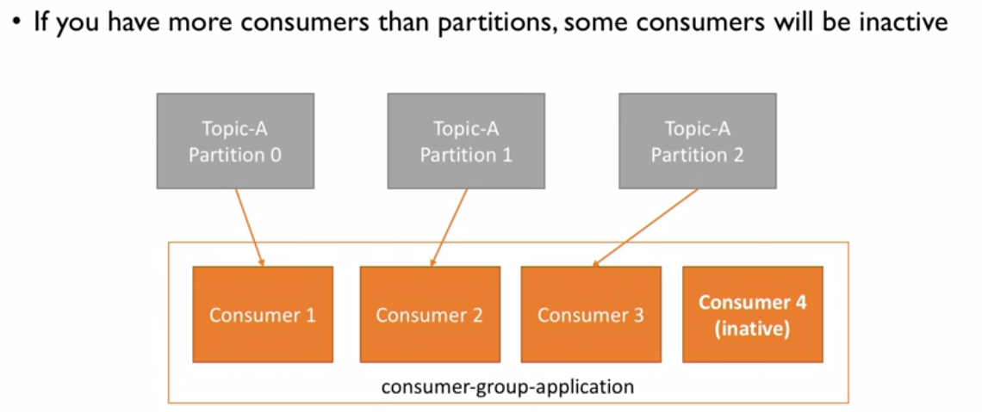
Consumers :What if too many Consumers

Slide 26
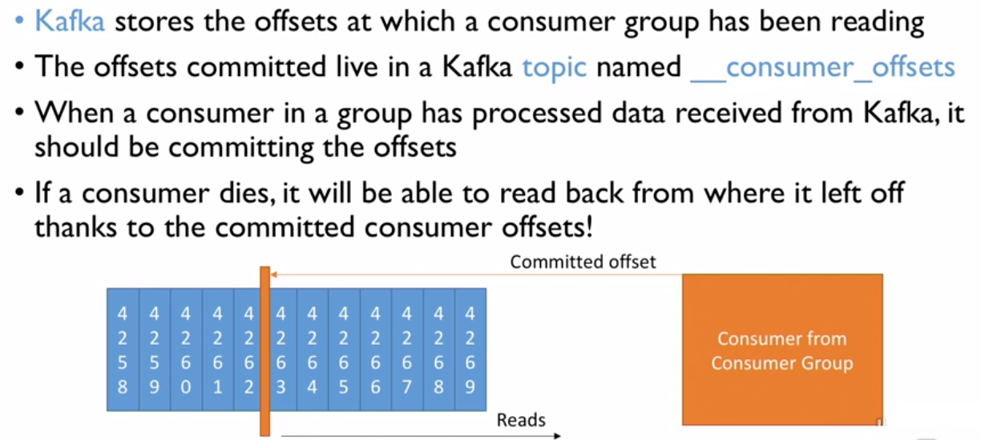
Consumers Offsets

Slide 27
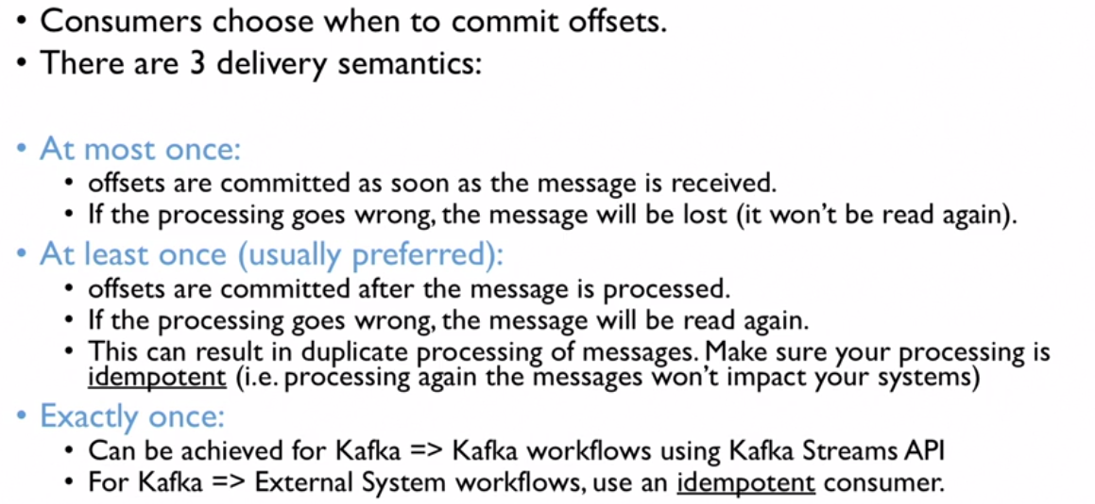
Delivery Semantics of Consumers

Slide 28
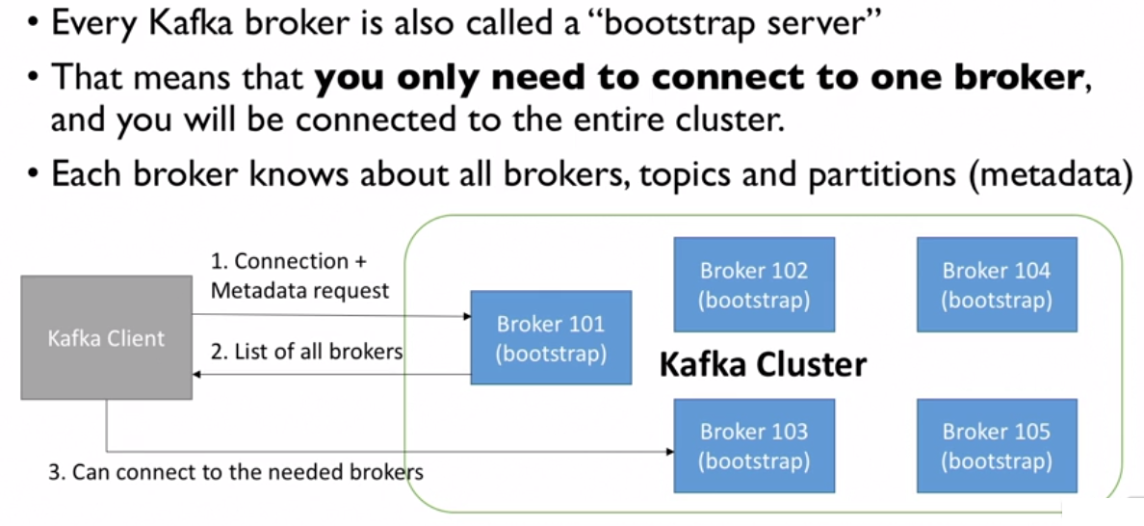
Kafka Broker Discovery

Slide 29
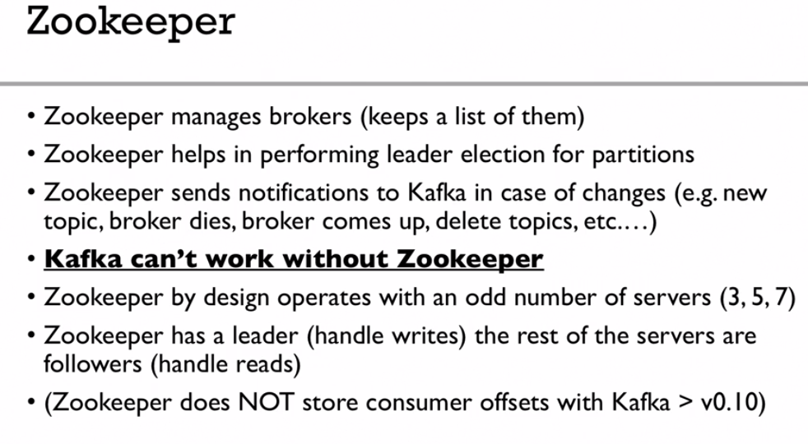

Slide 30
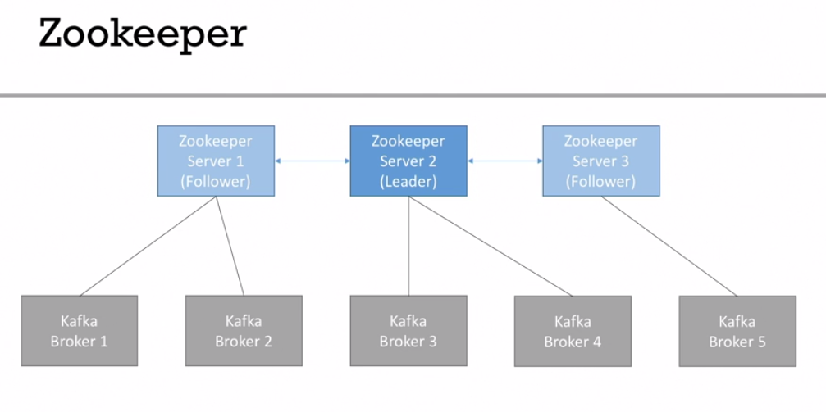

Slide 31
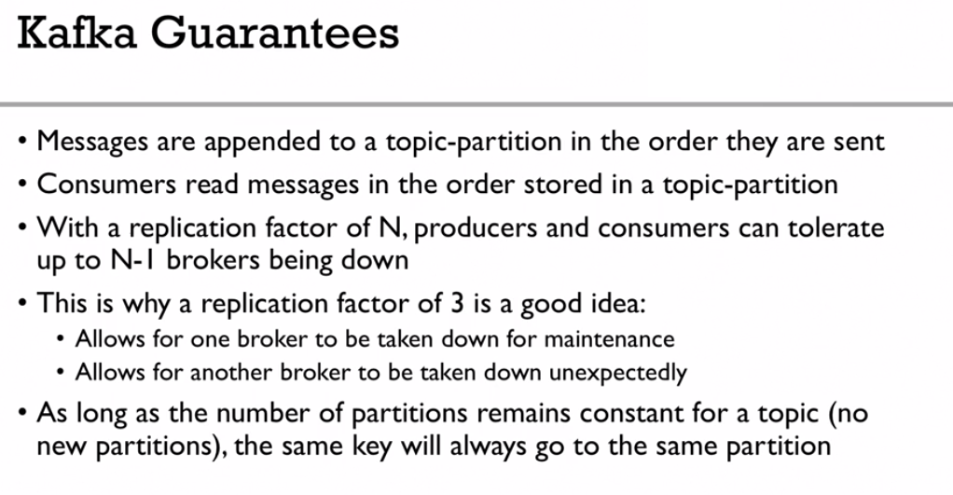

Slide 32
